Slide 1
Scanning Tunneling Microscopy
David Camparmo

Slide 2
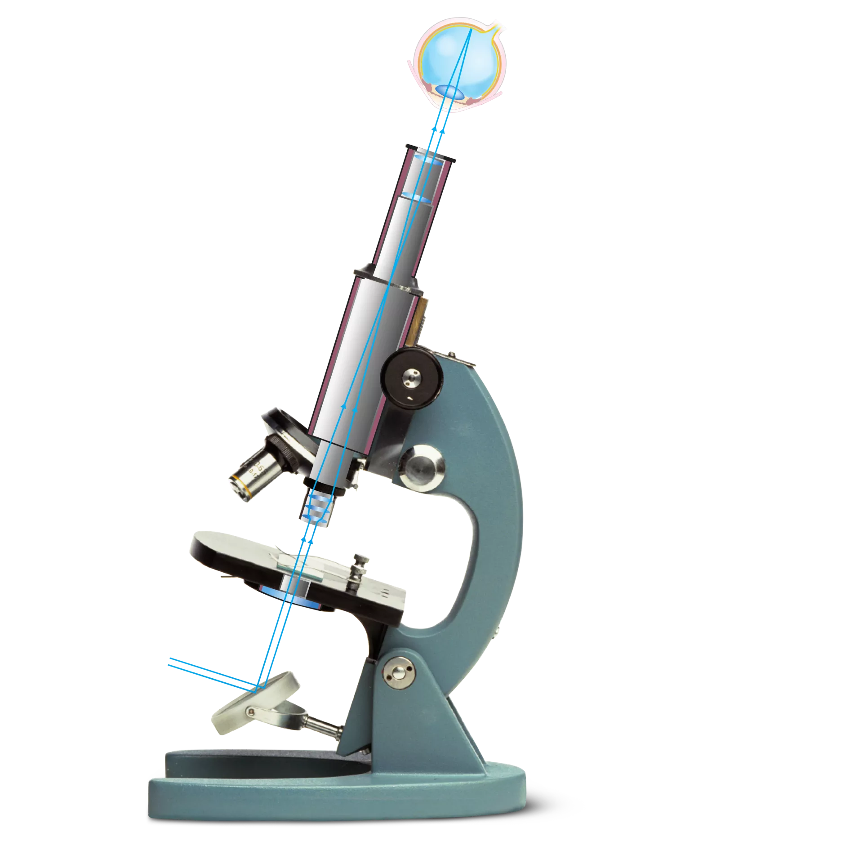
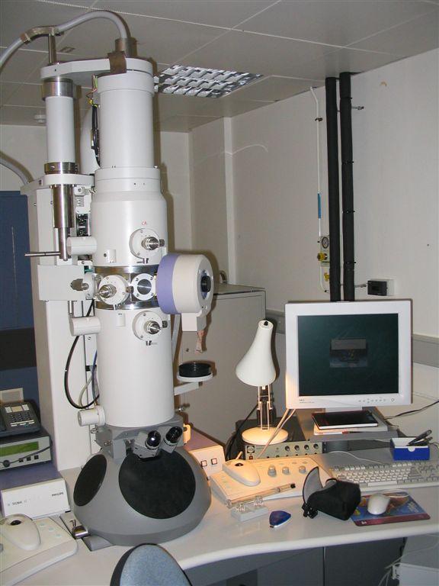
Overview: History of Microscope
Optical Microscope: Resolution limit 200nm
Invented in the 17th century
Uses visible light with lenses to magnify small objects
Scanning Electron Microscope: Resolution limit 2nm
Developed 1937
Use a beam of accelerated electrons as a source of illumination
Scanning Tunneling Micro scope: resolution limit 0.2nm
First developed in 1981
Uses quantum tunneling to produce images

Slide 3
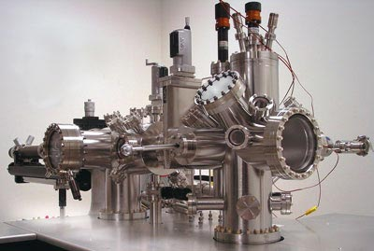

Slide 4
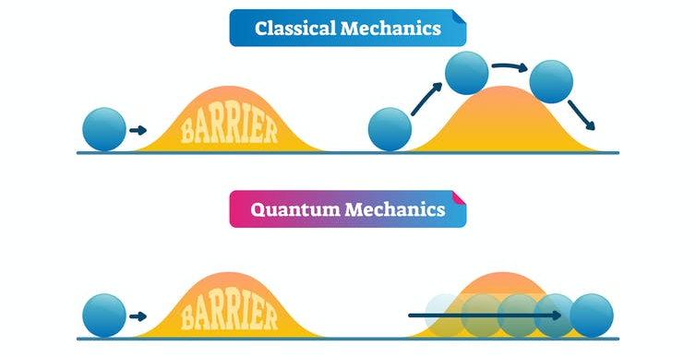
What is Tunneling?

Slide 5
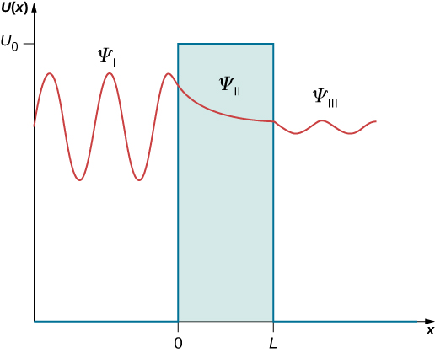
What is Tunneling?

Slide 6
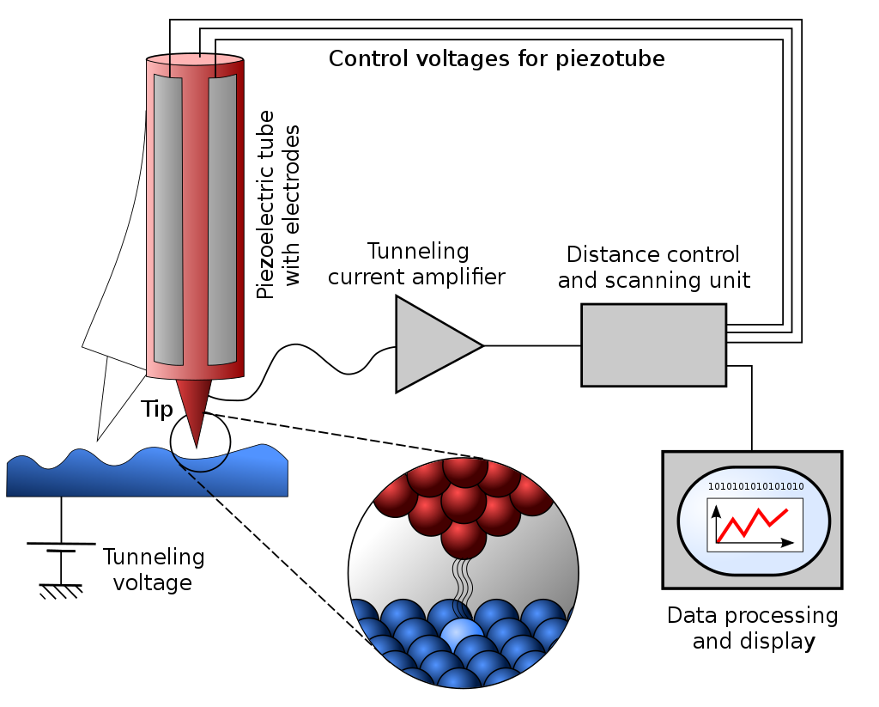
Scanning Tunneling Microscope

Slide 7
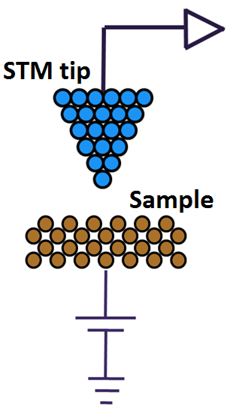
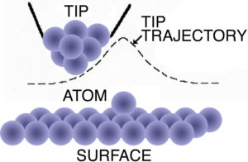
How Scanning Works
The tip of a STM is brought very close to the sample
which has voltage is applied to it
This voltage allows electrons to tunnel from the sample material to the tip
The Space between the tip of the STM and the sample acts as a barrier
A piezoelectric device is used to move the tip and scan across the surface of the sample

Slide 8
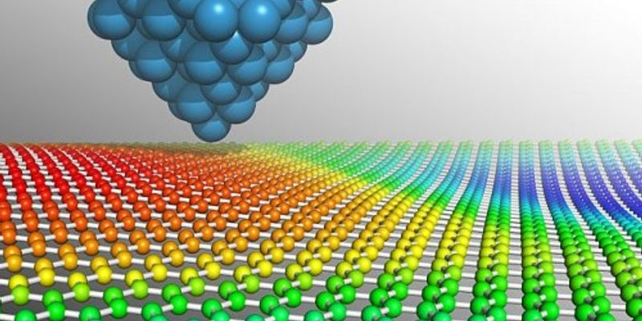

Slide 9
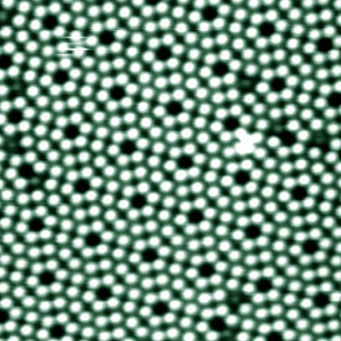
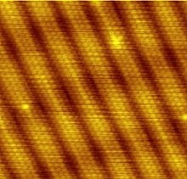
Images Produced Using STM
Silicone Atoms
Clean Gold Surface

